Slide 1
Virtual Memory Management and Page Replacement Algorithms
Notes:
These slides are intended to help a teacher develop a presentation. This PowerPoint covers the entire chapter and includes too many slides for a single delivery. Professors are encouraged to adapt this presentation in ways which are best suited for their students and environment.

Slide 2
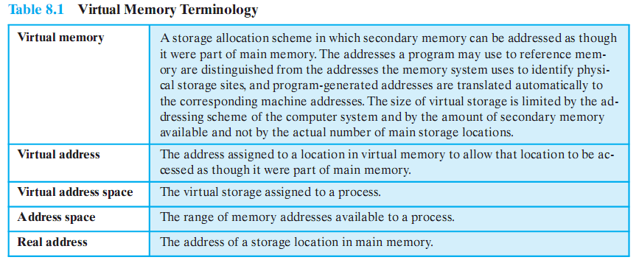
Terminology
Notes:
Some key terms related to virtual memory.

Slide 3
Key points in Memory Management
1) Memory references are logical addresses dynamically translated into physical addresses at run time
A process may be swapped in and out of main memory occupying different regions at different times during execution
2) A process may be broken up into pieces that do not need to located contiguously in main memory
Notes:
Two characteristics of paging and segmentation are the keys to this breakthrough in memory management:
All memory references within a process are logical addresses that are dynamically translated into physical addresses at run time.
A process may be swapped in and out of main memory occupying different regions of main memory at different times during the course of execution.
2. A process may be broken up into a number of pieces (pages or segments) and these pieces need not be contiguously located in main memory during execution.
The combination of dynamic run-time address translation and the use of a page or segment table permits this.

Slide 4
Breakthrough in Memory Management
If both of those two characteristics are present,
then it is not necessary that all of the pages or all of the segments of a process be in main memory during execution.
If the next instruction, and the next data location are in memory then execution can proceed
at least for a time
Notes:
If the piece (segment or page) that holds the next instruction to be fetched and the piece that holds the next data location to be accessed are in main memory,
then execution may proceed (at least for a time).

Slide 5
Execution of a Process
Operating system brings into main memory a few pieces of the program
Resident set - portion of process that is in main memory
An interrupt is generated when an address is needed that is not in main memory
Operating system places the process in a blocking state
Notes:
Suppose that it is time to bring a new process into memory.
The operating system begins by bringing in only one or a few pieces, to include the initial program piece and the initial data piece to which those instructions refer.
The portion of a process that is actually in main memory at any time is defined to be the resident set of the process.
As the process executes, things proceed smoothly as long as all memory references are to locations that are in the resident set.
Using the segment or page table, the processor always is able to deter mine whether this is so.
If the processor encounters a logical address that is not in main memory,
it generates an interrupt indicating a memory access fault.
The operating system puts the interrupted process in a blocking state and takes control.

Slide 6
Execution of a Process
Piece of process that contains the logical address is brought into main memory
Operating system issues a disk I/O Read request
Another process is dispatched to run while the disk I/O takes place
An interrupt is issued when disk I/O complete which causes the operating system to place the affected process in the Ready state
Notes:
For the execution of this process to proceed later, the operating system will need to bring into main memory the piece of the process that contains the logical address that caused the access fault.
For this purpose, the operating system issues a disk I/O read request.
After the I/O request has been issued, the operating system can dispatch an other process to run while the disk I/O is performed.
Once the desired piece has been brought into main memory, an I/O interrupt is issued, giving control back to the operating system, which places the affected process back into a Ready state.

Slide 7
Implications of this new strategy
More processes may be maintained in main memory
Only load in some of the pieces of each process
With so many processes in main memory, it is very likely a process will be in the Ready state at any particular time
A process may be larger than all of main memory
Notes:
More processes may be maintained in main memory.
Because we are only going to load some of the pieces of any particular process, there is room for more processes.
This leads to more efficient utilization of the processor because it is more likely that at least one of the more numerous processes will be in a Ready state at any particular time.
2. A process may be larger than all of main memory.
Without the scheme a programmer must be acutely aware of how much memory is available.
If the program being written is too large, the programmer must devise ways to structure the program into pieces that can be loaded separately in some sort of overlay strategy.
With virtual memory based on paging or segmentation, that job is left to the operating system and the hardware. As far as the programmer is concerned, he or she is dealing with a huge memory, the size associated with disk storage.
The operating system automatically loads pieces of a process into main memory as required.

Slide 8
Real and Virtual Memory
Real memory
Main memory, the actual RAM
Virtual memory
Memory on disk
Allows for effective multiprogramming and relieves the user of tight constraints of main memory
Notes:
Refer to table 8.2 in the book for a comparison of the characteristics of paging and segmentation, with and without the use of virtual
memory.

Slide 9
Support Needed for Virtual Memory
Hardware must support paging and segmentation
Operating system must be able to manage the movement of pages and/or segments between secondary memory and main memory
Notes:
For virtual memory to be practical and effective, two ingredients are needed.
there must be hardware support for the paging and/or segmentation scheme to be employed.
the operating system must include software for managing the movement of pages and/or segments between secondary memory
and main memory.

Slide 10
Paging
Each process has its own page table
Each page table entry contains the frame number of the corresponding page in main memory
Two extra bits are needed to indicate:
whether the page is in main memory or not
Whether the contents of the page has been altered since it was last loaded
Notes:
In the discussion of simple paging, we indicated that each process has its own page table.
When all of its pages are loaded into main memory, the page table for a process is created and loaded into main memory.
Each page table entry contains the frame number of the corresponding page in main memory.
A page table is also needed for a virtual memory scheme based on paging.
Again, it is typical to associate a unique page table with each process. (Figure 8.2a – next slide).
The page table entries become more complex because only some of the pages of a process may be in main memory.
A bit is needed in each page table entry to indicate whether the corresponding page is present (P) in main memory or not.
If the bit indicates that the page is in memory, then the entry also includes the frame number of that page.
The page table entry includes a modify (M) bit, indicating whether the contents of the corresponding page have been altered since the page was last loaded

Slide 11
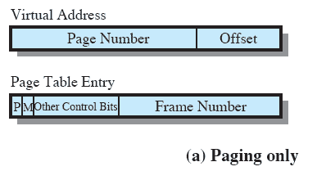
Paging Table
Notes:
This is a repeat of the notes on the previous slide
It is typical to associate a unique page table with each process. (Figure 8.2a – this slide).
A bit is needed in each page table entry to indicate whether the corresponding page is present (P) in main memory or not.
If the bit indicates that the page is in memory, then the entry also includes the frame number of that page.
The page table entry includes a modify (M) bit, indicating whether the contents of the corresponding page have been altered since the page was last loaded

Slide 12
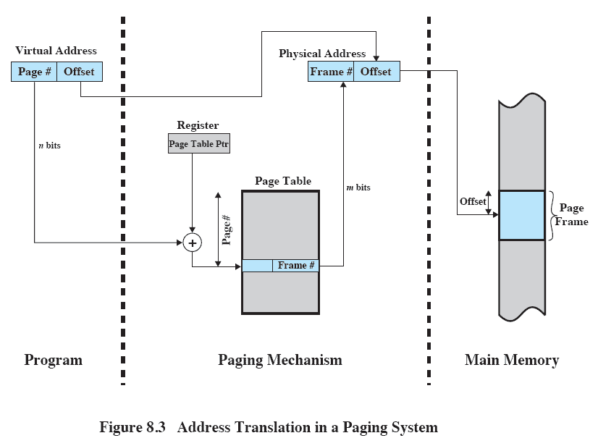
Address Translation
Notes:
The basic mechanism for reading a word from memory involves using a page table to translate a virtual/logical address,
consisting of page number and offset,
Into a physical address,
consisting of frame number and offset,
Because the page table is of variable length, depending on the size of the process, we cannot expect to hold it in registers.
Instead, it must be in main memory to be accessed.
Figure 8.3 suggests a hardware implementation.
When a particular process is running, a register holds the starting address of the page table for that process.
The page number of a virtual address is used to index that table and look up the corresponding frame number.
This is combined with the offset portion of the virtual address to produce the desired real address.
Typically, the page number field is longer than the frame number field (n > m).

Slide 13
Replacement Policy
When all of the frames in main memory are occupied and it is necessary to bring in a new page, the replacement policy determines which page currently in memory is to be replaced.
Notes:
This topic is sometimes difficult to explain because several interrelated concepts are involved:
• How many page frames are to be allocated to each active process
• Whether the set of pages to be considered for replacement should be limited to those of the process that caused the page fault or encompass all the page frames in main memory
• Among the set of pages considered, which particular page should be selected for replacement
When all of the frames in main memory are occupied and it is necessary to bring in a new page to satisfy a page fault,
the replacement policy determines which page currently in memory is to be replaced.

Slide 14
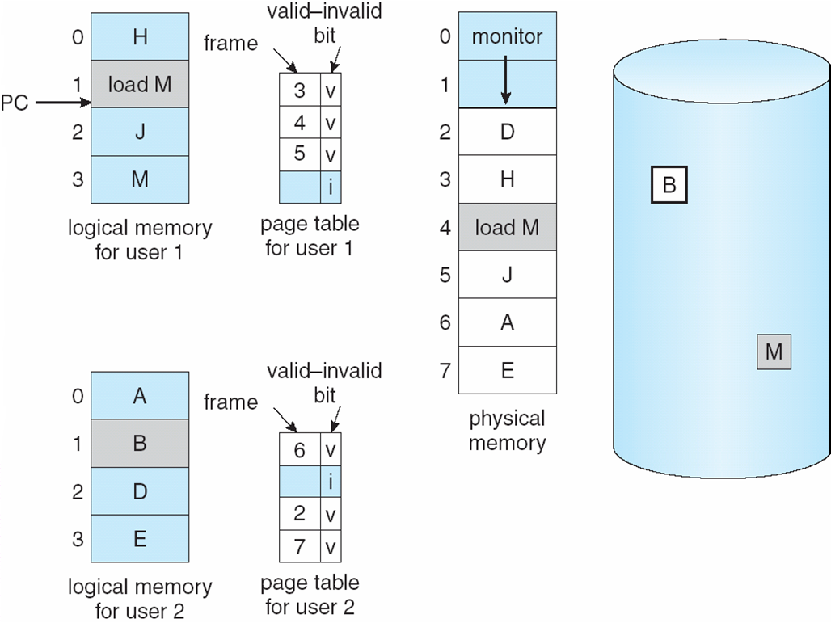
Need For Page Replacement

Slide 15
Basic Replacement Algorithms
There are certain basic algorithms that are used for the selection of a page to replace, they include
Optimal
Least recently used (LRU)
First-in-first-out (FIFO)
Examples

Slide 16
Examples
An example of the implementation of these policies will use a page address stream formed by executing the program is
2 3 2 1 5 2 4 5 3 2 5 2
Which means that the first page referenced is 2,
the second page referenced is 3,
And so on.
Notes:
Figure 8.15 gives an example of the optimal policy. The example assumes a
fixed frame allocation (fixed resident set size) for this process of three frames. The
execution of the process requires reference to five distinct pages. The page address
stream formed by executing the program is
232152453252
which means that the first page referenced is 2, the second page referenced is 3, and
so on. The optimal policy produces three page faults after the frame allocation has
been filled.

Slide 17
Optimal policy
Selects for replacement that page for which the time to the next reference is the longest
But Impossible to have perfect knowledge of future events
Notes:
The optimal policy selects for replacement that page for which the time to the next reference is the longest.
This policy results in the fewest number of page faults.
BUT Clearly, this policy is impossible to implement, because it would require the operating system to have perfect knowledge of future events.
However, it does serve as a standard against which to judge real world algorithms.

Slide 18
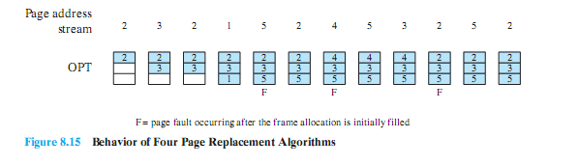
Optimal Policy Example
The optimal policy produces three page faults after the frame allocation has been filled.

Slide 19
Least Recently Used (LRU)
Replaces the page that has not been referenced for the longest time
By the principle of locality, this should be the page least likely to be referenced in the near future
Difficult to implement
One approach is to tag each page with the time of last reference.
This requires a great deal of overhead.
Notes:
The least recently used (LRU) policy replaces the page in memory that has not been referenced for the longest time.
By the principle of locality, this should be the page least likely to be referenced in the near future.
And, in fact, the LRU policy does nearly as well as the optimal policy.
The problem with this approach is the difficulty in implementation.
One approach would be to tag each page with the time of its last reference;
this would have to be done at each memory reference, both instruction and data.
Even if the hardware would support such a scheme, the overhead would be tremendous.
Alternatively, one could maintain a stack of page references, again an expensive prospect.

Slide 20
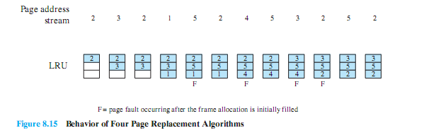
LRU Example
The LRU policy does nearly as well as the optimal policy.
In this example, there are four page faults

Slide 21
First-in, first-out (FIFO)
Treats page frames allocated to a process as a circular buffer
Pages are removed in round-robin style
Simplest replacement policy to implement
Page that has been in memory the longest is replaced
But, these pages may be needed again very soon if it hasn’t truly fallen out of use
Notes:
The first-in-first-out (FIFO) policy treats the page frames allocated to a process as a circular buffer, and pages are removed in round-robin style.
All that is required is a pointer that circles through the page frames of the process.
This is one of the simplest page replacement policies to implement.
The logic behind this choice is that one is replacing the page that has been in memory the longest:
A page fetched into memory a long time ago may have now fallen out of use.
This reasoning will often be wrong, because there will often be regions of program or data that are heavily used throughout the life of a program.
Those pages will be repeatedly paged in and out by the FIFO algorithm.

Slide 22
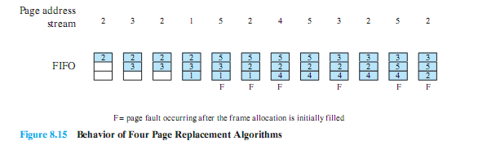
FIFO Example
The FIFO policy results in six page faults.
Note that LRU recognizes that pages 2 and 5 are referenced more frequently than other pages, whereas FIFO does not.
Notes:
Continuing our example in Figure 8.15, the FIFO policy results in six page faults.
Note that LRU recognizes that pages 2 and 5 are referenced more frequently than other pages, whereas FIFO does not.
Although the LRU policy does nearly as well as an optimal policy, it is difficult to implement and imposes significant overhead.
On the other hand, the FIFO policy is very simple to implement but performs relatively poorly.
Over the years, operating system designers have tried a number of other algorithms to approximate the performance of LRU while imposing little overhead.

Slide 23
Clock Policy
Uses and additional bit called a “use bit”
When a page is first loaded in memory or referenced, the use bit is set to 1
When it is time to replace a page, the OS scans the set flipping all 1’s to 0
The first frame encountered with the use bit already set to 0 is replaced.
Notes:
Camera jumps to animation of clock policy at http://gaia.ecs.csus.edu/~zhangd/oscal/ClockFiles/Clock.htm
The simplest form of clock policy requires the association of an additional bit with each frame, referred to as the use bit.
When a page is first loaded into a frame in memory, the use bit for that frame is set to 1.
Whenever the page is subsequently referenced (after the reference that generated the page fault), its use bit is set to 1.
The set of frames that are candidates for replacement is considered to be a circular buffer, with which a pointer is associated.
When a page is replaced, the pointer is set to indicate the next frame in the buffer after the one just updated.
When it comes time to replace a page, the operating system scans the buffer to find a frame with a use bit set to zero.
Each time it encounters a frame with a use bit of 1, it resets that bit to zero and continues on.
If any of the frames in the buffer have a use bit of zero at the beginning of this process, the first such frame encountered is chosen for replacement.
If all of the frames have a use bit of 1, then the pointer will make one complete cycle through the buffer, setting all the use bits to zero, and stop at its original position, replacing the page in that frame.
This policy is similar to FIFO, except that, in the clock policy, any frame with a use bit of 1 is passed over by the algorithm.

Slide 24
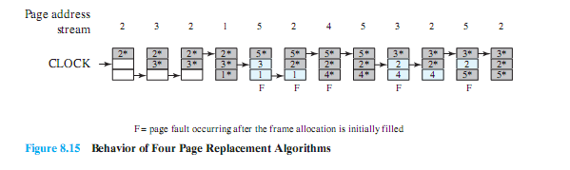
Clock Policy Example
Note that the clock policy is adept at protecting frames 2 and 5 from replacement.
Notes:
The presence of an asterisk indicates that the corresponding use bit is equal to 1,
and the arrow indicates the current position of the pointer.
Note that the clock policy is adept at protecting frames 2 and 5 from replacement.

Slide 25
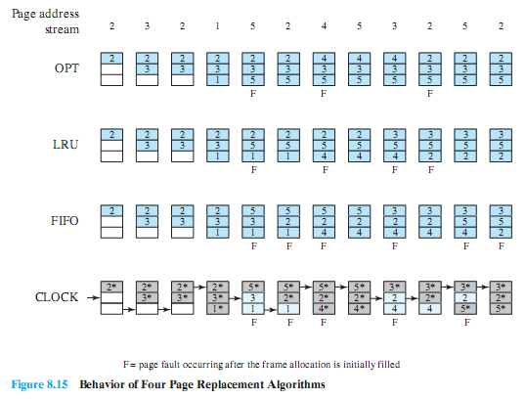
Combined Examples

Slide 26
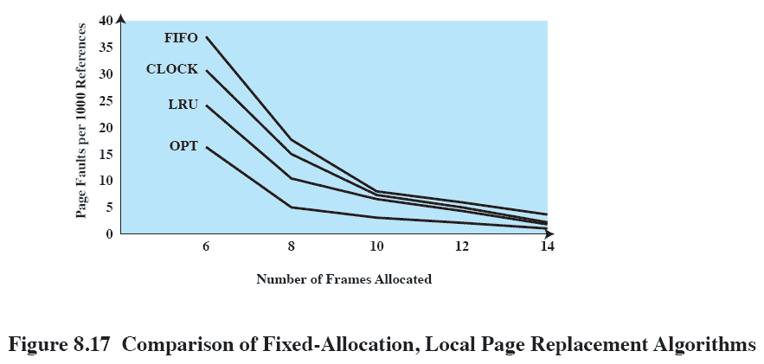
Comparison
Notes:
Figure 8.17 shows the results of an experiment reported in, which compares the four algorithms that we have been discussing;
It is assumed that the number of page frames assigned to a process is fixed.
The results are based on the execution of 0.25 x 10⁶ references in a FORTRAN program, using a page size of 256 words.
Baer ran the experiment with frame allocations of 6, 8, 10, 12, and 14 frames.
The differences among the four policies are most striking at small allocations, with FIFO being over a factor of 2 worse than optimal.
All four curves have the same shape as the idealized behavior shown in Figure 8.11b.
In order to run efficiently, we would like to be to the right of the knee of the curve (with a small page fault rate) while at the same time keeping a
small frame allocation (to the left of the knee of the curve).
These two constraints indicate that a desirable mode of operation would be at the knee of the curve.

Slide 27
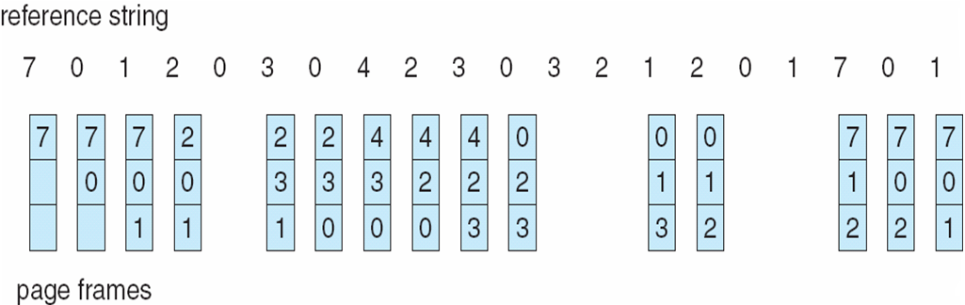
FIFO Page Replacement

Slide 28
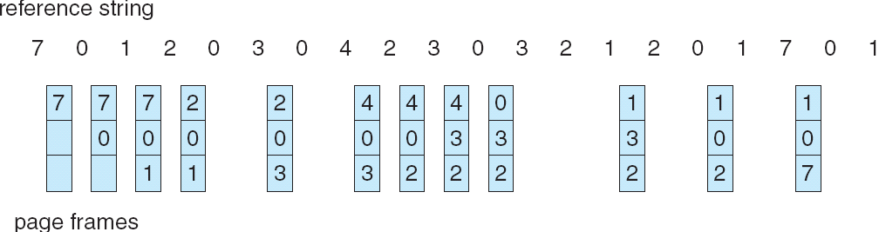
LRU Page Replacement

